Slide 1
X-Browser-1
Software Engineering
University of Massachusetts Lowell
Team: Phuc (Patrick) Tran - Project Manager
Stephen Ho - UI Designer
Hunter Stevens - Tester
Xuhao Wang - Front-end Developer
Aurimas Alkevicius - Developer

Slide 2
Table of Contents
Introduction and overview to the Product by Hunter Stevens
Website Overview by Stephen Ho
Diagrams by Phuc Tran
Prototype Demonstration by Xuhao Wang
Current Constraints and Future Development by Aurimas Alkevicius

Slide 3
Website Overview

Slide 4
Project Introduction - Brief Overview
Project Motivation: This project was created in order to address the problem with modifying multiple web browsers at a time during web development.
Goal: To establish and create an effective and user friendly solution that will enhance the efficiency of the website development process.
Solution: Combining the use of a text editor and real-time web browsing into one product that will display the result of the text editor on multiple browsers at the same time in order to reduce the amount of time it will take in order to open and refresh multiple browsers and create a more efficient and user friendly result.

Slide 5
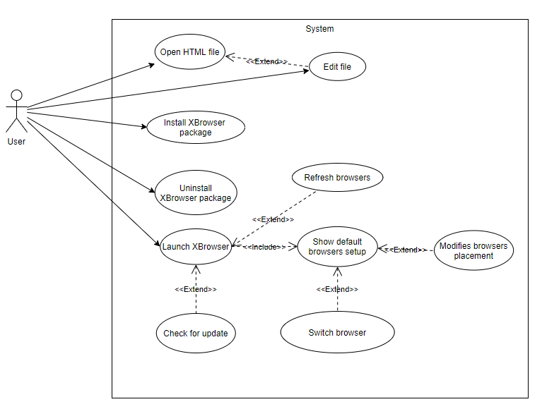
Project Introduction - Backend Explanation
This solution was designed to be simple and user friendly in order to prevent the least confusion possible by the user as well as enabling ease of access to anyone who wants to try our plugin.

Slide 6
Project Introduction - User Functionality
Installation: X-Browser was designed in order to be the most user-friendly possible, and will follow a few simple steps in order to get up and running.
Install the X-Browser plugin to atom.
Run the X-Browser plugin and select which browsers you wish to display.
Open a file and begin typing to see the results in the selected browsers in real time.

Slide 7
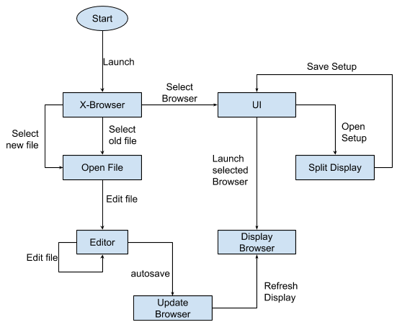
State Diagram
Launch X-Browser
Select File to open
Existing File
New File
Select Browser(s)
Firefox
Google Chrome
Safari
Microsoft Edge
Display Browser
Autosave on change
Refresh display to show recent updates

Slide 8
Prototype Demonstration

Slide 9
Constraints
Compatibility
Only compatible with supported browsers.
Time
Some additional features could not be implemented in time prior to this presentation.
Requirements
Our plugin requires specific system and networking requirements.

Slide 10
Future Development
Shortcuts for toggling between web-browser tabs
Discrepancy detection mechanism
Package Documentation

